Slide 1
Analysis of Vitamin-D Usage And Hospital Readmittance
Brian Tobin ~ D206 Assignment

Slide 2
Part I: Research Question
Describe one question or decision that you will address using the data set you chose. The summarized question or decision must be relevant to a realistic organizational need or situation.
Will Vitamin-D help in the reduction of hospital readmissions within the first 30 days of initial admissions?

Slide 3
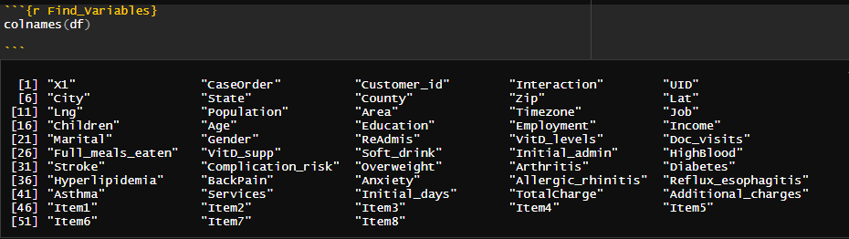
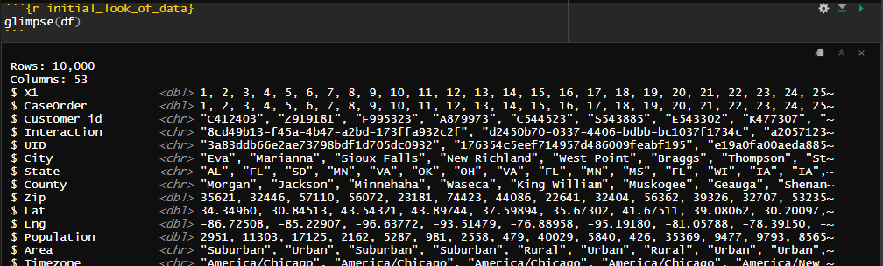
Part I: Research Question
B. Describe the variables in the data set and indicate the specific type of data being described. Use examples from the data set that support your claims.
When starting to look at the data in the CSV, I first looked at the column names and then a glimpse to see a snapshot of the data within the columns. Vitamin-D was the only column type that appeared twice, one as levels and the other as supplements.

Slide 4
Part II: Data-Cleaning Plan
Explain the plan for cleaning the data
Explain the plan for cleaning the data
The plans is to look at the columns and see what the data consists of and see if there are any NAs, duplicates, and to see if there are any variables that need mutating or changing from a character to a numeric value.
Then some columns will be dropped as they will not be necessary for the investigation
Columns started with 53 and removed 26 for a total of 27 columns. This reduced the dataset from 3,874KB to 3,075KB

Slide 5
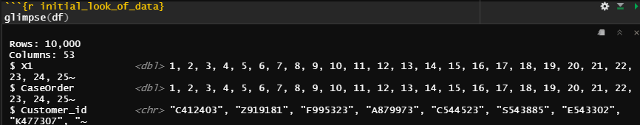
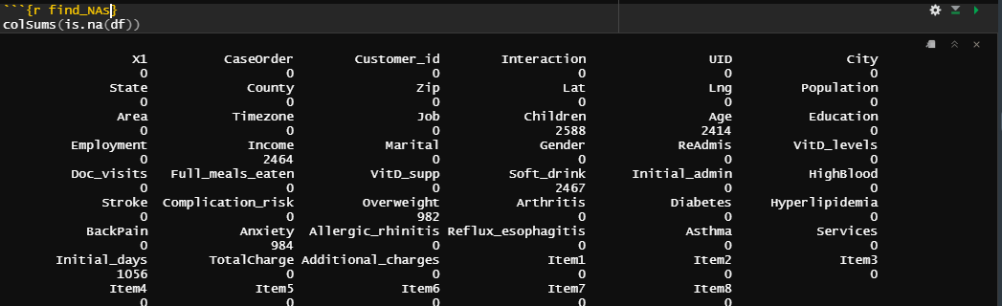
Part II: Data-Cleaning Plan
Explain the plan for cleaning the data
C. Explain the plan for cleaning the data by doing the following:

Slide 6
Part II: Data-Cleaning Plan
Explain the plan for cleaning the data
C. Explain the plan for cleaning the data by doing the following:

Slide 7
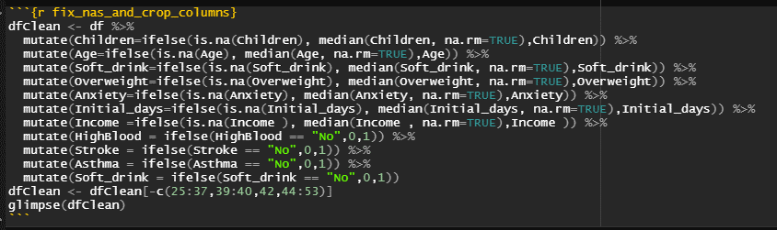
Part II: Data-Cleaning Plan
Explain the plan for cleaning the data – Part 2
NAs will be mutated with median numbers. Some columns with Yes/No will be mutated to 1,0.

Slide 8
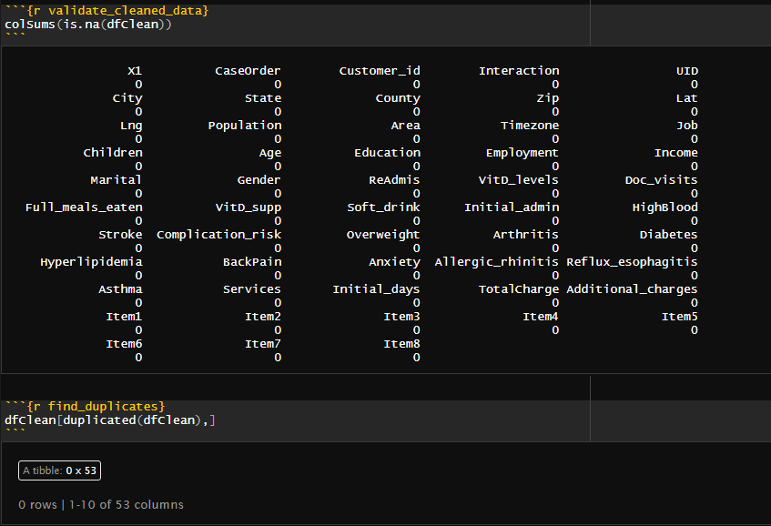
Part II: Data-Cleaning Plan
Explain the plan for cleaning the data – Part 3
The result will have no NAs and will check for duplicate data

Slide 9

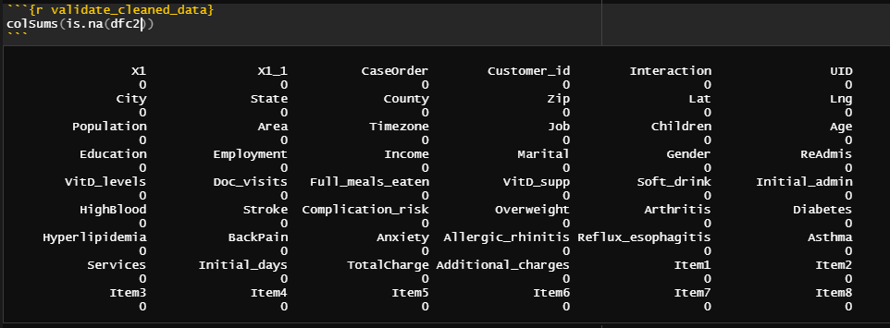
Part II: Data-Cleaning Plan
Explain the plan for cleaning the data – Part 3
The clean data will be stored in a new CSV and then loaded into R for further analysis.
Validation of the clean datafile shows the cleaned data.

Slide 10
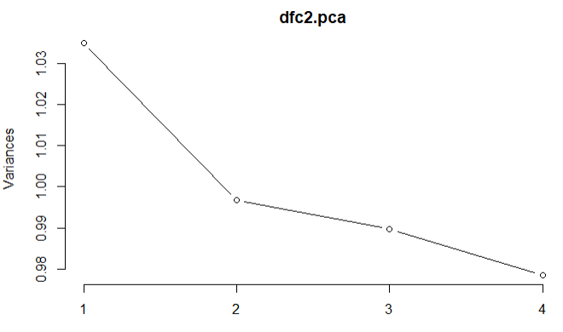
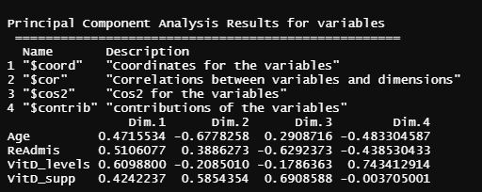
Part III: Data Cleaning
E. Apply principal component analysis (PCA) to identify the significant features of the data set by doing the following:
List the principal components in the data set.
Initial Plot of Components.

Slide 11
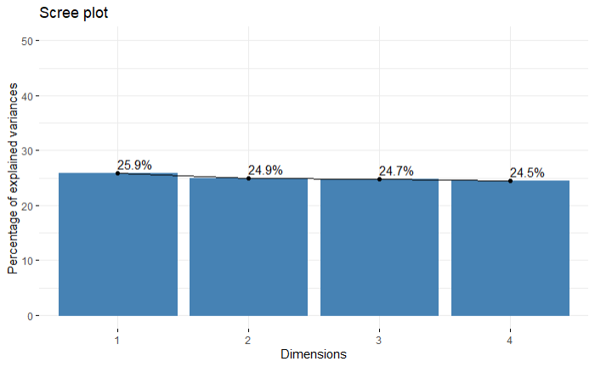
Part III: Data Cleaning
E. Apply principal component analysis (PCA) to identify the significant features of the data set by doing the following:
1. List the principal components in the data set.
Analysis of variables for PCA(3)
Scree Plot of Principle Components: Age, ReAdmis, VitD_levels, VitD_supp(3)

Slide 12
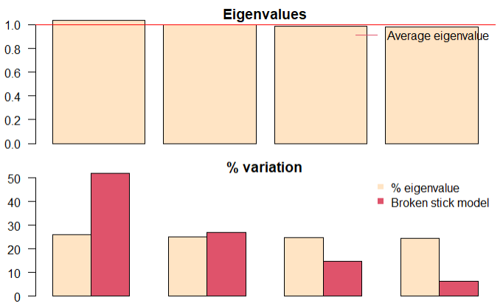
Part III: Data Cleaning
Kaiser-Guttman criterion and Broken Stick criterion
The Kaiser-Guttman suggests that only the first two components should be used but is contradicted by the Broken Stick Criteria. This means that there is a possibility of split analysis.(4)
Further analysis is required.

Slide 13
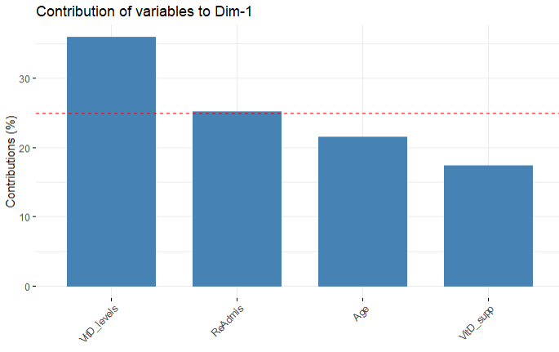
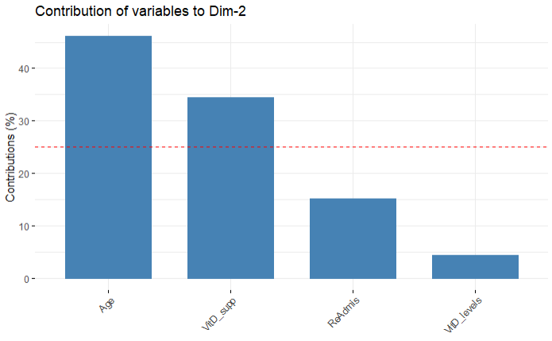
Part III: Data Cleaning
Axes tests Contributions of Variables in PCA
1-Axis Test
2-Axis Test
Kaiser-Guttman criterion and Broken Stick criterion

Slide 14
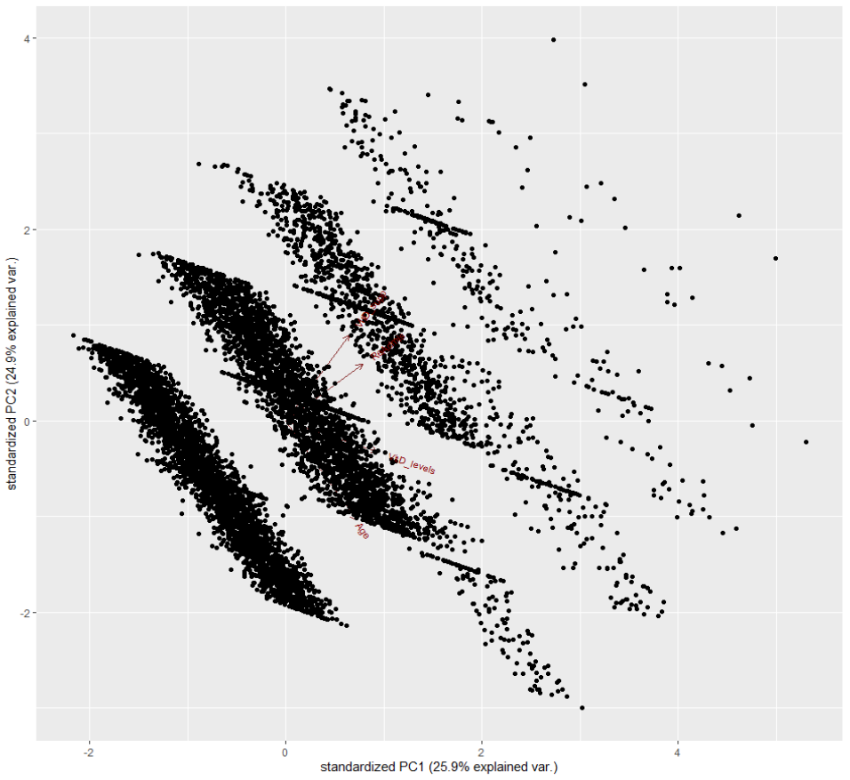
Part III: Data Cleaning
E. Apply principal component analysis (PCA) to identify the significant features of the data set by doing the following:
2. Describe how you identified the principal components of the data set.
3. Describe how the organization can benefit from the results of the PCA(2)
Principle Components: Age, ReAdmis, VitD_levels, VitD_supp
According to the data and PCA, there is a direct correlation between VitD supplements and Re-Admissions.
Age and VitD Levels were on a down trend.

Slide 15
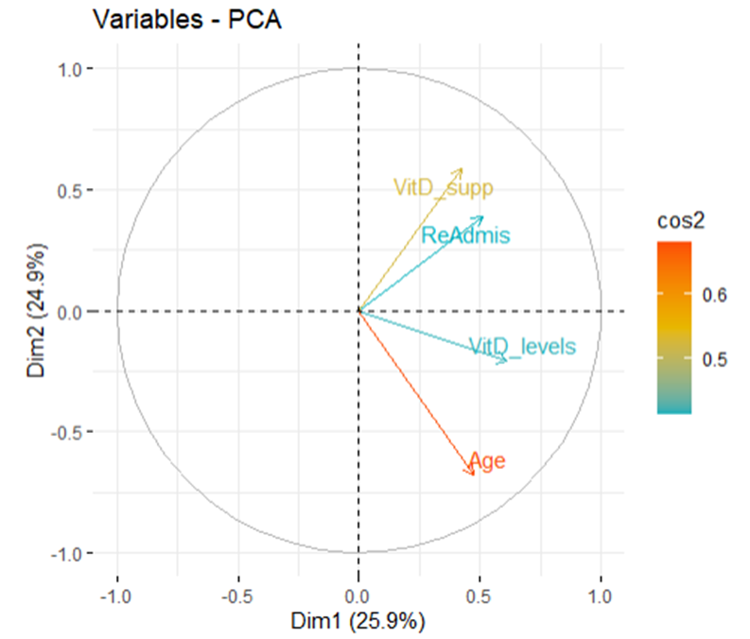
Part III: Data Cleaning
Principle components show a correlation and contributes to a possible reason of hospital Re-Admissions. Initial find of components were due to the initial investigation.
Principle Components: Age, ReAdmis, VitD_levels, VitD_supp
According to the data and PCA, there is a direct correlation between VitD supplements and Re-Admissions.
Age and VitD Levels were on a down trend.

Slide 16
Summary
The data was cleaned, saved, and the analysis was performed on the cleaned dataset. Principle components show a correlation and contributes to a possible reason of hospital Re-Admissions. Initial find of components were due to the initial investigation.
Principle Components: Age, ReAdmis, VitD_levels, VitD_supp
According to the data and PCA, there is a direct correlation between VitD supplements and Re-Admissions.
Age and VitD Levels were on a down trend.

Slide 17
Part IV. Supporting Documents
Websites:
Hayden, Luke. “R PCA (Principal Component Analysis).” DataCamp Community, Datacamp.com, 9 Aug. 2018, www.datacamp.com/community/tutorials/pca-analysis-r
UC. “Data cleaning and steps for PCA preparation” – https://uc-r.github.io/pca
Kassambara. “PCA - Principal Component Analysis Essentials” sthda.com, 9 Sep. 2017 http://www.sthda.com/english/articles/31-principal-component-methods-in-r-practical-guide/112-pca-principal-component-analysis-essentials/#visualization-and-interpretation
Ivan, Morgun. “Principal Component Analysis (PCA) in R”, proft.me, 15 Nov 2016, https://en.proft.me/2016/11/15/principal-component-analysis-pca-r/

Slide 18
Closing
Are There any questions?
Thank you
Contact Information:
Brian Tobin
btobin9@wgu.edu

